Slide 1
Food Waste Reduction
Forrest Fallon MBC 638

Slide 2
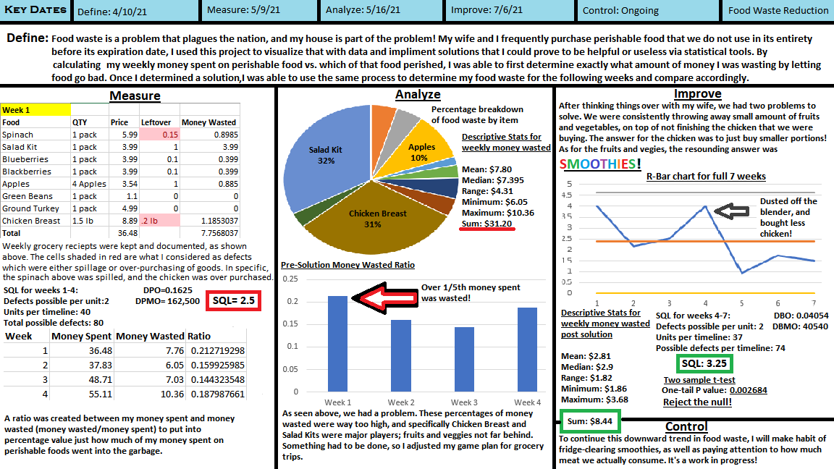

Slide 3
So…what’s the deal?
An unfortunate reality that we live with is the fact that food waste is rampant. My household is not innocent in this, and I wanted to use this project to quantify just how bad it was; and try to improve it.
I specifically centered my data around perishable food that would not last from week to week. If I purchased a pack of blueberries last week and they have not been eaten, they are likely not consumable and therefore are wasted money. I began taking tally of these occurrences via receipts from grocery trips and tallied the results.
Because of the length of this class, I was only able to measure for a handful of weeks. Though it is a small sample size, my data is bolstered by the fact that each week contains roughly 10-20 different opportunities for measurement via the average amount of perishable food I purchase weekly. Being that there was no “right or wrong” category, this was clearly continuous data.
Measurement

Slide 4
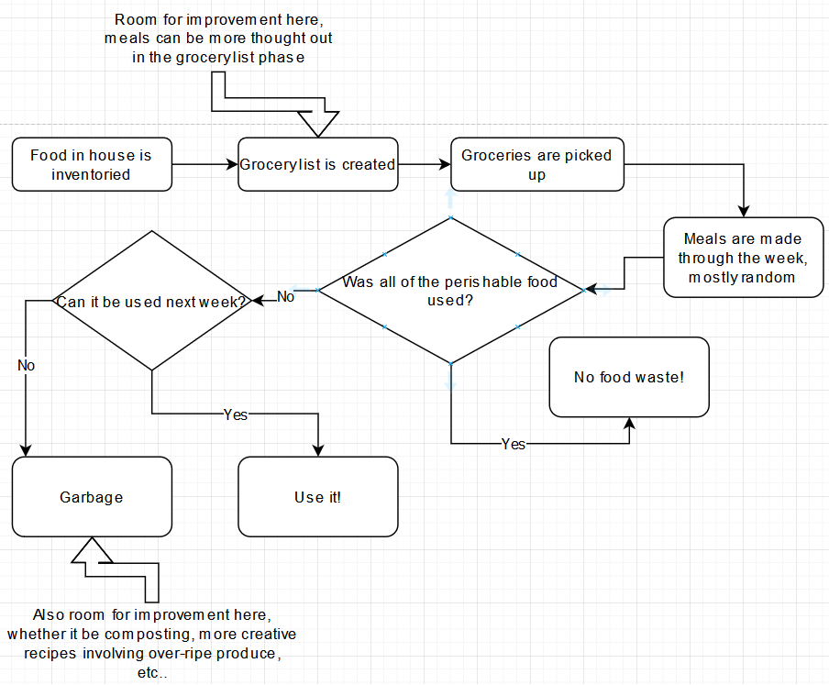
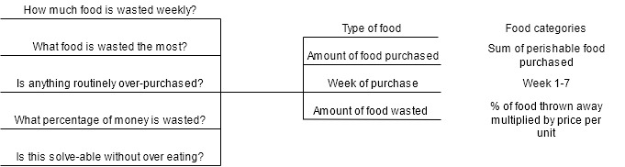
Flow chart
Data Stratification Tree
Questions
X-variables
Measurements
Grocery trip

Slide 5
What would be considered successful?
With continuous data such as price per week, it was up to me to determine what would be consider to be considered a success. Simply returning a lower mean money wasted after implementing a solution is not enough to say with certainty that I improved this process. Especially with a small sample size, results need to be resounding in order to convince anyone that something actually changed.
My operational definition of success in this study was the following:
“There is a clear downtrend in wasted money, and the results continue to take place for more than one week.”
In order to satisfy this criteria, I decided to run multiple statistical tests such as a One Sided T-Test for hard statistical evidence, as well as R-Bar and X-Bar charts to visualize the results and how they compare to the first few weeks of data.

Slide 6
Sigma Quality Level
In all honesty, determining what a “defect” could be for this study was difficult. Being that I was in full control of the food entering my house during the study, there was no excuse for including food that was inedible upon purchase for whatever reason. Instead, I considered the following as potential defects:
Spillage: If an item was dropped and contaminated, that should be considered defected and marked as such.
Over-Purchasing: If everything in my power was done to consume this food in a healthy manner (not over eating for the sake of the project), and more than 1/5th of the food remained at the end of the week, I considered this an over-purchase. Most of my defects came from over-purchasing.
Below is my pre-solution SQL calculation, showing that my process was far from perfect.
Defects Per Unit (piece of food):2 DPO: 0.1625 Units Per Timeline (weeks 1-4): 40 DPMO: 162,500
Total Possible Defects: 80
Actual Defects: 13 SQL Value: 2.5

Slide 7
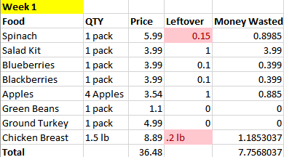

First Findings
As shown here, each item was documented alongside its price and how much was leftover respective to the unit size. For instance, 0.2lbs of chicken was thrown out this first week. This percentage was then multiplied by the price, and that lead me to Money Wasted.
I then found the totals of both Money Spent and Money Wasted and created a ratio between them that showed me just how much of my money was wasted, week by week.

Slide 8
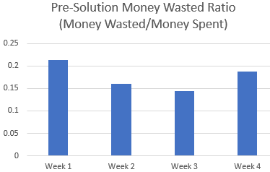
First results visualized
As shown here, the results can be interpreted as not acceptable. The first week topping over 1/5th of money spent being thrown away showed me that I was doing the right project because something needed fixing. What I did next was figure out exactly where most of my money was being wasted.

Slide 9
Food items breakdown
And there we have it…salad kits and chicken breast take up over 60% of my wasted money! This just goes to show that you can bring healthy food into the house, but the real effort comes with committing to eating it.
Within my analyze phase, I spent a while just thinking about how to fix all of my wasteful habits, not just the ones this pie chart (pun intended) shows. I found a few solutions that ended up turning this problem around.

Slide 10
First solution, the obvious one.
This one was easy; we were habitually leaving 0.1-0.25lbs of chicken behind. I would blindly grab a package of chicken breast that looked decent and move on; instead, I started looking for packages specifically weighing right at 1lb. If anything, it is better to undershoot than overshoot in terms of expensive items. I would rather supplement the meal with cheaper proteins than have chicken leftover that would not be eaten.
Thus began solution 1!

Slide 11
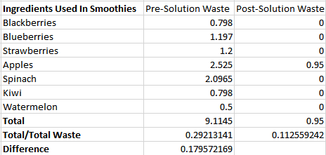
Solution 2, the wallet saver…
My 2nd solution may end up saving me money for the rest of my life, as well as keep me and my family healthy! That solution would be the amazing smoothie. The bottom third of my wasted money lied within fruits and veggies, most of which go well with each other when blended. And the best part of it is, a fruit can be past its normal consumption date and still qualify as smoothie material. At the end of the week, I could just throw whatever was left in the fridge into the blender, hit blend, and not only was I solving my money problem, but I was also creating a much healthier breakfast routine.
I was so impressed with the findings after implementing this solution that I just had to know what the exact difference was. Shown to the right are the exact differences in total money wasted, specific to foods contained in smoothies, which ended up being almost 18%.

Slide 12
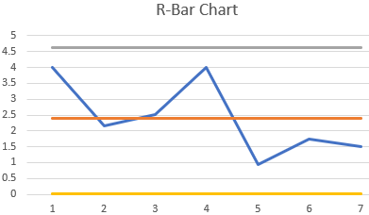
But how effective was it really?
The most visually effective chart I created was the R-bar chart, which shows exactly where things took a turn for the better. Had I not taken a few hours to think about how I can improve, things very well could have kept trending up after week 4 instead of taking a steep decline. And my work is not even done! My results did not magically reach 0, but I had a great start here.
My SQL post-solution was calculated at 3.25, Much better! Still room for improvement though.

Slide 13
T-Test for probability, left-tailed
In order to quantify my results and provide hard statistical evidence that something is in-fact different with my approach to shopping and eating, I used a two sample T-Test. The reason a T-Test is the best choice for my problem is because of my sample size. By allotting my data into weeks, that only allowed for 7 total data samples.
Being that n1+n2 < 30, I am only able to use a T-Test, as opposed to Z. That’s fine though! Degrees of freedom are a small extra step to take.
Hypothesis Statements: based on my previous findings, my mean money wasted on food
was $7.80
Ho: My weekly wasted money will be more than or equal to $7.80
Ha: My weekly wasted money will be less than $7.80

Slide 14
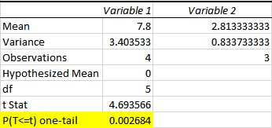
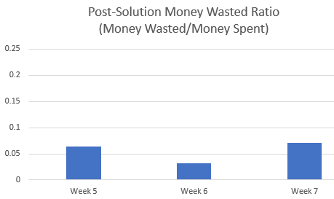
T-Test Results
Made painfully obvious here, the alpha level would have to be very low in order to not reject this null hypothesis. With a one-tail P-value of 0.0026, an impact was clearly made.
I can safely say that I have statistically significant evidence that my solutions made a positive impact on the amount of money wasted by throwing away food.
As if the above was not enough, the bar chart post-solution is almost laughable. This is what the results should have looked like in the first place, however, I am happy knowing that an impact was made.

Slide 15
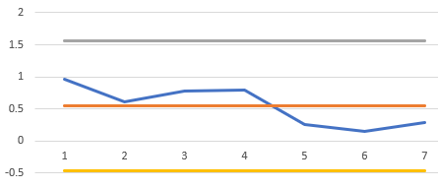
So, now what?
Although things are looking better, there is still work to be done!
As shown on the X-bar chart below, it could be argued that I am trending back up in wasteful spending. It is also shown via the 2nd pie chart that new foods being introduced to the mix are not quite accounted for yet. This is clearly a continuous process that will need adjusting frequently. My goal from here is to find a process that allows for 0 food waste out of my household; it may be lofty, but it will serve to keep me and my family’s food habits in check.

